Slide 1
PART 4
Advance Looping & List

Slide 2
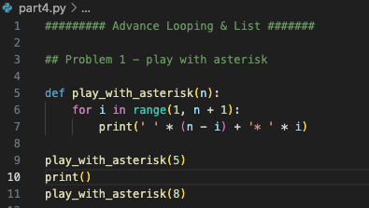
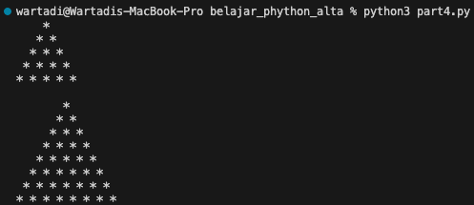
Problem 1 - Play With Asterisk
Input Program
Output Program

Slide 3
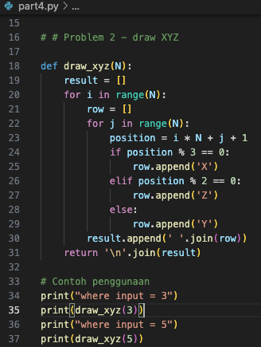
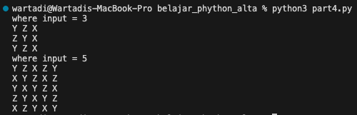
Problem 2 - Draw XYZ
Input Program
Output Program

Slide 4
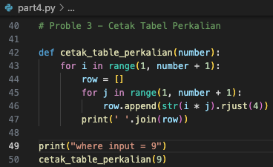
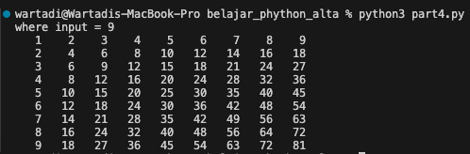
Problem 3 - Cetak Tabel Perkalian
Input Program
Output Program

Slide 5
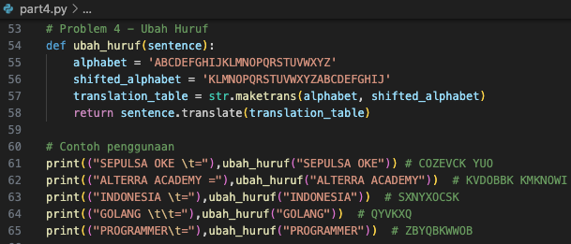

Problem 4 - Ubah Huruf
Input Program
Output Program

Slide 6
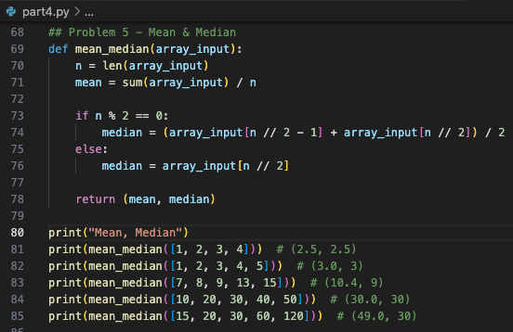
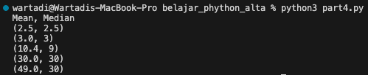
Problem 5 - Mean dan Median
Input Program
Output Program

